Slide 1
Web Security
Part 2

Slide 2
Plan
Same Origin Policy
XSS
CSRF

Slide 3

Same Origin Policy

Slide 4
Same Origin Policy - Trust
Read/embed resources
<script src="https://example.com/lib.js">
</script>
Send data
<form action="https://example.com/login">
… <input type="password”> …
</form>

Slide 5
Same Origin Policy
Generally speaking, user agents isolate different origins and permit controlled communication between origins.
Adam Barth
RFC 6454
Notes:
http://www.ietf.org/rfc/rfc6454.txt

Slide 6
Origin
{ scheme, host, port }

Slide 7
Same Origin Policy
http://store.company.com/dir/page.html
№ | URL | Outcome | Reason
1 | http://store.company.com/dir2/other.html | ?
2 | http://store.company.com/dir/inner/another.html | ?
3 | https://store.company.com/secure.html | ?
4 | http://store.company.com:81/dir/etc.html | ?
5 | http://news.company.com/dir/other.html | ?
Notes:
https://developer.mozilla.org/en-US/docs/Web/Security/Same-origin_policy
IE: Trust Zones and Port

Slide 8
Same Origin Policy
http://store.company.com/dir/page.html
№ | URL | Outcome | Reason
1 | http://store.company.com/dir2/other.html | Success
2 | http://store.company.com/dir/inner/another.html | Success
3 | https://store.company.com/secure.html | Failure | Different protocol
4 | http://store.company.com:81/dir/etc.html | Failure | Different port
5 | http://news.company.com/dir/other.html | Failure | Different host
Notes:
https://developer.mozilla.org/en-US/docs/Web/Security/Same-origin_policy
IE: Trust Zones and Port

Slide 9
Same Origin
iframe.contentWindow
window.parent
window.open
window.opener

Slide 10
Cross Origin
xorigin.location.href = "…";
window.postMessage(…);

Slide 11
Cross Origin
writes are typically allowed
embedding is typically allowed
reads are typically not allowed

Slide 12
Embedding
<script src="..."></script>
<link rel="stylesheet" href="...">
<img src="...">
<video>, <audio>
<object>, <embed>, <applet>
<frame>, <iframe>

Slide 13
SOP and real life
login.example.com store.example.com
document.origin = example.com
evil.example.com
HTML5 window.PostMessage()

Slide 14
postMessage()
window.addEventListener("message", receiveMessage, false);
function receiveMessage(event) {
var origin = event.origin || event.originalEvent.origin
if (origin !== "https://login.example.com")
return;
// …
}
-----------------------------------------------------------------------------------
var popup = window.open(…);
var msg = “schedule event …”;
popup.postMessage(msg, “https://store.example.com”);
Notes:
Receive data from untrusted origin
Send sensitive data to untrusted origin

Slide 15
Same Origin Policy vs XMLHttpRequest
We CAN make a request, but we CAN’T read a response
document.domain trick doesn’t work
Internet Explorer takes port into account

Slide 16
Cross Origin Resource Sharing (CORS)
Access-Control-Allow-Origin:
Access-Control-Allow-Credentials:
Access-Control-Allow-Methods:
Notes:
https://developer.mozilla.org/en-US/docs/Web/HTTP/CORS

Slide 17
Cross Origin Resource Sharing (CORS)
Invocations of the XMLHttpRequest API in a cross-site manner
Web Fonts
WebGL textures
Images/video frames drawn to a canvas using drawImage

Slide 18
Cross Origin Resource Sharing (CORS)
Access-Control-Allow-Origin: <origin> | *

Slide 19
Cross Origin Resource Sharing (CORS)
Access-Control-Allow-Credentials: true

Slide 20
Cross Origin Resource Sharing (CORS)
Potential issues:
  All origins are permitted for “testing”
  Incorrect validation (regex)
  Header injection
Origin: http://wwwXnsa.gov
Origin: http://www.nsa.gov.evil.com
Origin: (null)

Slide 21
Cookies: scope
Cookie set at foo.example.com, domain parameter is | Scope of the resulting cookie
 | Non-IE browsers | Internet Explorer
(not set) | foo.example.com | *.foo.example.com
bar.foo.example.com | Not set: domain more specific than origin
foo.example.com | *.foo.example.com
baz.example.com | Not set: domain mismatch
example.com | *.example.com
ample.com | Not set: domain mismatch
.com | Not set: domain too broad, security risk

Slide 22
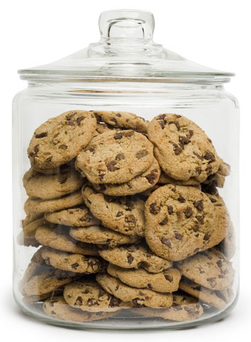
Cookies
IE: 50
Chrome: 180
Firefox: 150
Safari: 600
Edge: ?
JavaScript
document.cookie
Server
Set-Cookie
Notes:
http://browsercookielimits.iain.guru/

Slide 23
SameSite
Lax (default)
  not sent on normal cross-site subrequests
  sent when a user is navigating to the origin site
Strict
  will only be sent in a first-party contex
None
  will be sent in all contexts
Notes:
https://developer.mozilla.org/en-US/docs/Web/HTTP/Headers/Set-Cookie/SameSite

Slide 24
Same Origin Policy
Ambient credentials
Notes:
logged as admin and user in different tabs

Slide 25
Cross-Origin Writes
CSRF
Cross Site Request Forgery
https://www.owasp.org/index.php/CSRF

Slide 26
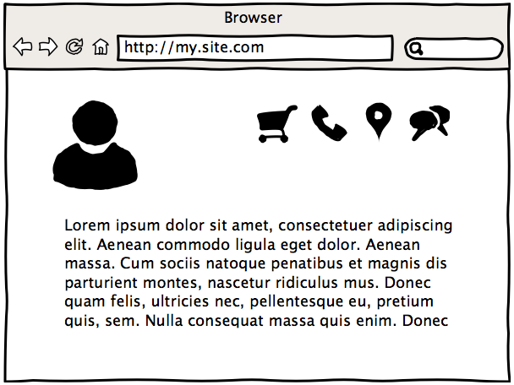
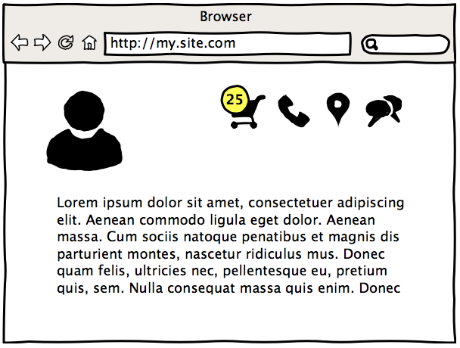
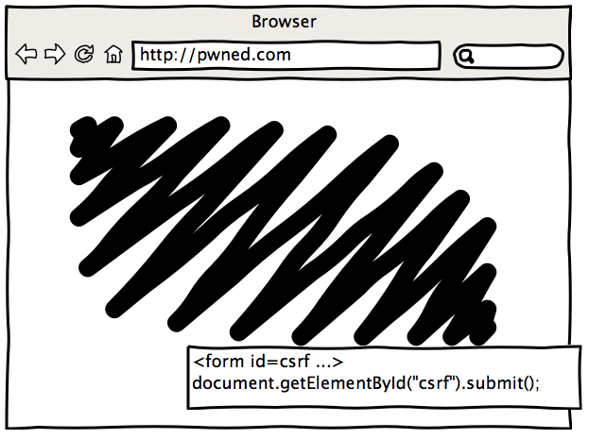
CSRF

Slide 27
CSRF Effects
Create/update/remove data on behalf victim
Hijack accounts
Leverage complex attacks

Slide 28
CSRF Mitigation
POST for write operations
Ad hoc protections
  Synchronizer Token Pattern
  Double submit cookies
  Cookie to header
Notes:
https://www.owasp.org/index.php/Cross-Site_Request_Forgery_(CSRF)_Prevention_Cheat_Sheet

Slide 29
Synchronizer Token Pattern
<form action="/order" method="POST">
<input type="hidden"
name="CSRFToken"
value="JwhKBtIPHEUV">
…
</form>

Slide 30
Double submit cookies
Set-Cookie: Csrf-token=i8XNjC4b8KV…Wgp2BFwql;…
<form action="/order" method="POST">
<input type="hidden"
name=”CSRFToken"
value="i8XNjC4b8KV…Wgp2BFwql">
…
</form>

Slide 31
Cookie to header
Send unpredictable value in HTTP header.
Set-Cookie: Csrf-token=i8XNjC4b8KVo…8Wgp2BFwql;…
X-Csrf-Token: i8XNjC4b8KVo…8Wgp2BFwql

Slide 32
Trust to Document
XSS
Cross Site Scripting
https://www.owasp.org/index.php/XSS

Slide 33
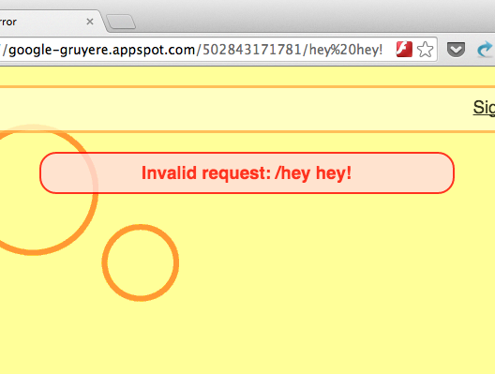
Notes:
https://google-gruyere.appspot.com/

Slide 34
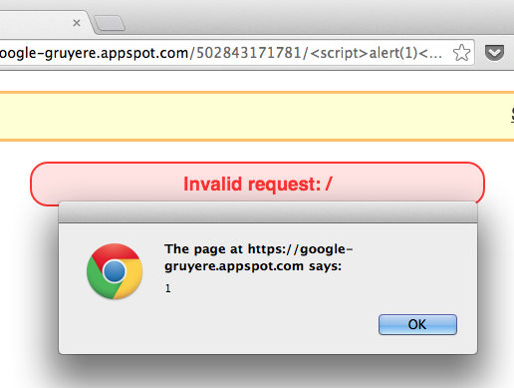

Slide 35
XSS Effects
Bypass Same-Origin Policy
Steal data, CSRF tokens
Deploy malware
Hijack accounts
Whatever…

Slide 36
Cross Site Scripting
Persistent
Reflected
Dom-based

Slide 37
Persistent XSS
Save data into
  Database, file, logs, etc.
Render data without escaping

Slide 38
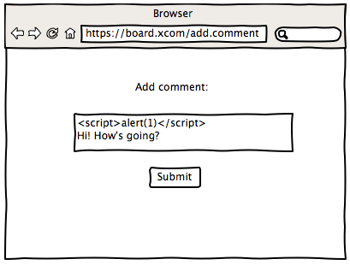
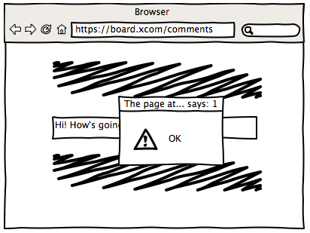
Site DB

Slide 39
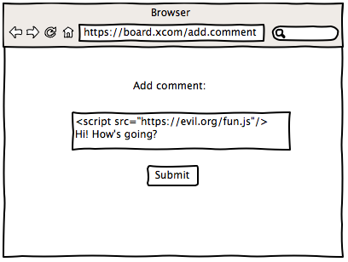
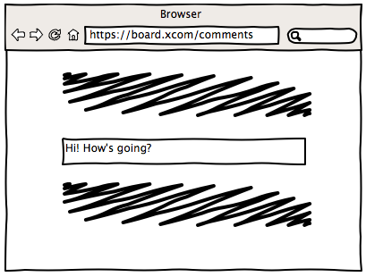

Slide 40
DOM Based XSS
JavaScript modifies DOM using untrusted data without proper escaping.

Slide 41
DOM Based XSS
<script>
var href = document.location.href;
var lang = href.substring(href.indexOf("lang=")+5);
document.write("Current language is " + lang);
</script>

Slide 42
DOM Based XSS
<script>
var h = document.location.href;
var page = h.substring(h.indexOf("page=")+5);
document.write("<iframe src=\"" + page + "\"></firame>");
</script>

Slide 43
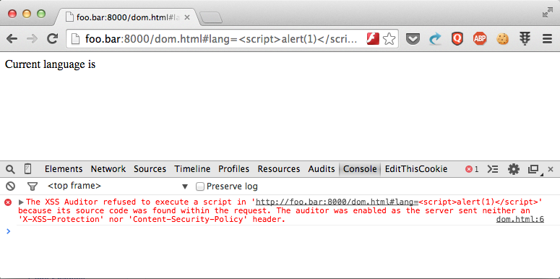
XSS protection

Slide 44
Input data processing path
Untrusted Input
Normalize
Validate
Filter
Output
Escaping
Storage
Binding API /
Escaping

Slide 45
XSS Prevention
<!– NEVER UNTRUSTED INPUT -->
<style>
NEVER UNTRUSTED INPUT
</style>
<script>
NEVER UNTRUSTED INPUT
</script>
<NEVER div NEVER id=…>
Notes:
https://www.owasp.org/index.php/XSS_(Cross_Site_Scripting)_Prevention_Cheat_Sheet

Slide 46
<div id=“userinfo” onclick=“…”>
User: Hedgehog in a fog
</div>
<img src=“user/1.png” style=“…”>
2
3
1
2
3

Slide 47
HTML Nodes
< | → | &lt;
> | → | &gt;
& | → | &amp;

Slide 48
HTML Attributes
Escape all non-alphanumerics with &#xHH;
“ | → | &#22;
‘ | → | &#27;
` | → | &#60;

Slide 49
src, href, …
Normalize attribute value
Whitelist allowed schema

Slide 50
src, href, …
<a href=“javascript:alert(1)”>
<a href=“JaVaScRiPt:alert(1)”>
<a href="ja&#x76;&#x61;script:alert(1)">
<a href="data:text/html;charset=utf-8,
%3Cscript%3Ealert%281%29%3C%2Fscript%3E”>

Slide 51
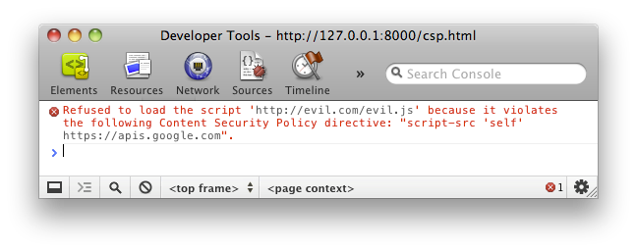
Content Security Policy
http://www.html5rocks.com/en/tutorials/security/content-security-policy/
Notes:
http://www.html5rocks.com/en/tutorials/security/content-security-policy/

Slide 52
Content Security Policy
<script>disabled by default</script>
<style>disabled by default</style>
eval(“disabled by default”);

Slide 53
Content Security Policy
script-src base-uri child-src connect-src font-src form-action frame-ancestors media-src object-src plugin-types report-uri style-src
Notes:
base-uri restricts the URLs that can appear in a pages <base> element.
child-src lists the URLs for workers and embedded frame contents. For example: child-src https://youtube.com would enable embedding videos from YouTube but not from other origins. Use this in place of the deprecated frame-src directive.
connect-src limits the origins to which you can connect (via XHR, WebSockets, and EventSource).
font-src specifies the origins that can serve web fonts. Google’s Web Fonts could be enabled via font-src https://themes.googleusercontent.com
form-action lists valid endpoints for submission from <form> tags.
frame-ancestors specifies the sources that can embed the current page. This directive applies to <frame>, <iframe>, <embed>, and <applet> tags. This directive cant be used in <meta> tags and applies only to non-HTML resources.
img-src defines the origins from which images can be loaded.
media-src restricts the origins allowed to deliver video and audio.
object-src allows control over Flash and other plugins.
plugin-types limits the kinds of plugins a page may invoke.
report-uri specifies a URL where a browser will send reports when a content security policy is violated. This directive cant be used in <meta> tags.
style-src is script-src’s counterpart for stylesheets.

Slide 54
Content Security Policy
none
self
unsafe-inline
unsafe-eval

Slide 55
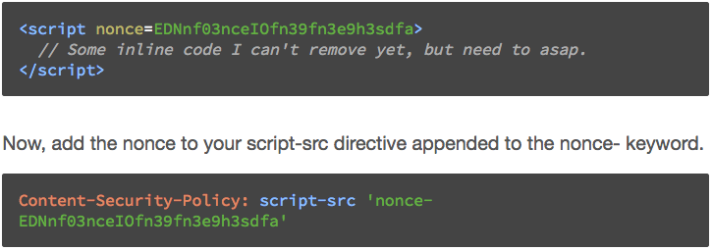
Content Security Policy

Slide 56
Michal Zalewski
Postcards from the post-XSS world
http://lcamtuf.coredump.cx/postxss/

Slide 57
But my users want enter HTML…
Markdown
BB-code
Wiki

Slide 58
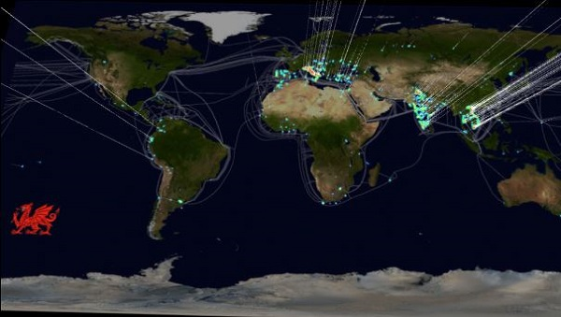
Example
300K hijacked SOHO routers with poisoned DNS
Notes:
http://news.dice.com/2014/03/03/bad-security-lets-attackers-hijack-300k-soho-nets/

Slide 59

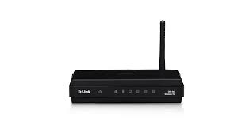
Internet
192.168.0.0
Internet Provider
195.214.232.10
10.0.0.0

Slide 60
How?
http://admin:admin@192.168.1.1/
userRpm/LanDhcpServerRpm.htm?
dhcpserver=1&
ip1=192.168.1.100&
ip2=192.168.1.199&
Lease=120&
gateway=0.0.0.0&
domain=&
dnsserver=106.187.36.85&
dnsserver2=8.8.8.8&
Save=%B1%A3+%B4%E6

Slide 61
User-level Protection
Always change default password
Use separate browser, or logout
Keep router firmware up-to-date
Use non-standard router IP

Slide 62
Application-level Protection
GET requests must be read only
Synchronizer Token Pattern
Ask user confirmation for critical actions
Notes:
https://www.owasp.org/index.php/Cross-Site_Request_Forgery_(CSRF)_Prevention_Cheat_Sheet#General_Recommendation:_Synchronizer_Token_Pattern

Slide 63
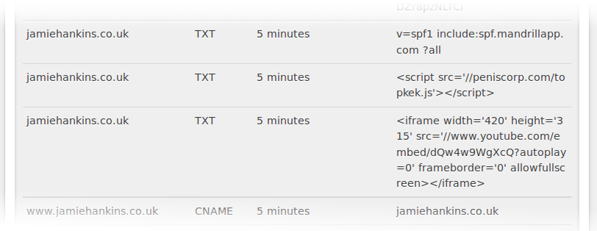
Example
Notes:
https://habrahabr.ru/post/237407/ (in web archive, no video)
https://www.youtube.com/watch?v=1anIUDvdCjY

Slide 64
Links
Learn
  https://google-gruyere.appspot.com/
Try
  https://polyglot.innerht.ml/

Slide 65
Questions?

Slide 66
Thank you!

